Slide 1


Performance Analysis of 5G New Radio (5G NR) Transmitter Models Using QAM Modulation Schemes
B. Tech (ECE / BML)
Project–II (BECE497J) Final Review
Team Member Details
Ms. Prarthna Puhan (22BEC0075)
Project Guide:
Dr. Shambavi K,
Professor Higher Academics Grade
School of Electronics Engineering, Vellore Institute of Technology.

Slide 2
Outline:
Introduction
Literature Review
Research Gaps and Problem Formulation
Relevance w.r.t SDG
Proposed System Design
Analytical and Theoretical Description
Software tool and Simulation & Design Parameters
Result Analysis
Conclusion
Impact on Society and Environment
Outcome
References

Slide 3
Introduction:
5G New Radio (5G NR) provides high data rates, low latency, and efficient spectrum use.
Modulation schemes such as 16-QAM, 64-QAM, and 256-QAM improve spectral efficiency by transmitting more bits per symbol.
Higher modulation orders are more sensitive to impairments such as I/Q imbalance, phase noise, carrier frequency offset (CFO), and power amplifier nonlinearity.
These impairments distort the signal, increase Error Vector Magnitude (EVM), and reduce reliability.
This project develops a MATLAB Simulink-based 5G NR transmitter model to evaluate performance under ideal, impaired, and compensated conditions.
Comparative analysis shows that 64-QAM provides the best balance between robustness, efficiency, and practical performance.

Slide 4
Literature Survey:
Author(s) | Year | Title | Methodology/Approach | Key Findings/Results | Limitations
Rappaport et al. [1] | 2019 | Wireless communications and applications above 100 GHz: Opportunities and challenges for 6G and beyond | Analytical study and measurement-based insights on sub-THz propagation | Identified feasibility, use cases, and challenges of >100 GHz bands for future wireless systems | Primarily conceptual; limited hardware-level impairment analysis
Goldsmith [2] | 2005 | Wireless Communications | Theoretical modeling of wireless channels and communication techniques | Established fundamental limits and performance metrics for wireless systems | Does not address modern RF impairments in high-frequency systems
Molisch [3] | 2011 | Wireless Communications | Statistical channel modeling and system-level analysis | Comprehensive understanding of fading, MIMO, and propagation effects | Limited focus on RF front-end impairments
Proakis & Salehi [4] | 2008 | Digital Communications | Mathematical analysis of digital modulation and detection | Provides baseline BER, EVM, and performance theory | Assumes ideal transceiver hardware
Parthasarathy et al. [5] | 2017 | Error vector magnitude analysis in generalized fading with co-channel interference | Analytical EVM modeling under fading and interference | Demonstrated EVM as a robust performance metric | Does not include hardware impairments explicitly
Tarighat et al. [6] | 2005 | Compensation schemes and performance analysis of IQ imbalances in OFDM receivers | Digital baseband compensation algorithmsSignificant BER improvement under IQ imbalance | Significant BER improvement under IQ imbalance | Focused mainly on receiver-side IQ imbalance

Slide 5
Literature Survey: (Contd…)
Author(s) | Year | Title | Methodology/Approach | Key Findings/Results | Limitations
Zou et al. [7] | 2009 | Joint compensation of IQ imbalance and phase noise in OFDM wireless systems | Joint estimation and compensation algorithms | Improved robustness under combined impairments | Increased computational complexity
Jovanović & Milenković [8] | 2022 | Transmitter IQ imbalance mitigation and PA linearization in SDRs | Experimental SDR-based compensation | Improved linearity and spectral performance | Limited to SDR platforms
Cripps [9] | 2006 | RF Power Amplifiers for Wireless Communications | Behavioral modeling of RF power amplifiers | Explained PA nonlinearity and efficiency trade-offs | Does not address system-level digital mitigation
Demir [10] | 2002 | Phase noise and timing jitter in oscillators with colored-noise sources | Analytical oscillator noise modelling | Accurate phase noise characterization | No direct system-level performance evaluation
Georgiadis & Kalialakis [11] | 2014 | Evaluation of EVM due to combined IQ imbalances and phase noise | Analytical and simulation-based EVM analysis | Quantified combined impairment impact on EVM | Limited modulation orders considered
Pyatin et al. [12] | 2023 | RF interface quality assessment in 4G/5G | Measurement-based evaluation of RF impairments | Highlighted dominant impairments affecting EVM | Technology-specific results
Valkama et al. [15] | 2001 | Advanced methods for I/Q imbalance compensation | Adaptive DSP algorithms | Effective IQ imbalance mitigation | High algorithmic complexity

Slide 6
Literature Survey: (Contd…)
Author(s) | Year | Title | Methodology/Approach | Key Findings/Results | Limitations
Song et al. [16] | 2018 | Blind estimation algorithms for I/Q imbalance | Blind signal processing techniques | Reduced need for training sequences | Slower convergence
Zou et al. [17] | 2006 | Joint compensation of IQ imbalance and phase noise in OFDM | Joint estimation framework | Improved system robustness | Increased processing overhead
Tandur & Moonen [18] | 2010 | Efficient compensation of transmitter and receiver IQ imbalance | Low-complexity compensation schemes | Effective for both Tx and Rx | Assumes accurate synchronization
Morgan et al. [19] | 2006 | Memory polynomial model for digital predistortion | Behavioral PA modeling | Widely adopted DPD model | Requires extensive parameter estimation
Somasundaram et al. [20] | 2023 | DPD on mmWave GaN PA using 64-QAM | Experimental broadband DPD | Improved linearity at mmWave | Hardware-specific implementation
Leshem & Yemini [21] | 2017 | Phase noise compensation for OFDM systems | DSP-based phase noise mitigation | Significant ICI reduction | Performance depends on noise statistics
Mehrpouyan et al. [22] | 2012 | Joint estimation of channel and oscillator phase noise in MIMO | Joint estimation algorithms | Improved MIMO detection accuracy | High computational complexity
Nasir et al. [23] | 2016 | Timing and carrier synchronization in wireless systems | Synchronization algorithm survey | Comprehensive overview of sync techniques | No direct EVM-focused analysis

Slide 7
Research Gaps and Problem Formulation:
Most studies analyze individual RF impairments, while 5G NR experiences combined impairments in practice.
High-order QAM (64/256-QAM) performance under realistic impairments is insufficiently explored.
Gap between ideal/theoretical models and practical 5G NR hardware behavior.
Limited before-and-after suppression analysis to quantify mitigation effectiveness.
Lack of 3GPP-compliant evaluation using EVM and threshold metrics.
Few works provide comparative analysis across multiple QAM orders under identical conditions.

Slide 8
Relevance of Problem Statement w.r.t. SDG
SDG 9 – Industry, Innovation and Infrastructure: Enhances reliability and performance of 5G communication systems for stronger digital infrastructure.
SDG 7 – Affordable and Clean Energy: Improves transmitter efficiency by reducing distortions and optimizing power usage.
SDG 11 – Sustainable Cities and Communities: Supports smart cities through stable connectivity for transport, healthcare, and IoT systems.
Promotes efficient spectrum use and better signal quality in modern networks.
Contributes to sustainable and advanced wireless communication systems.

Slide 9
Proposed System Design
Build a three-stage Simulink model: baseline, impaired, and compensated transmitter.
Generate NR test signals and route them through RF transmission blocks.
Include interpolation, buffering, and receiver-side decoding modules.
Emulate real conditions using I/Q imbalance, phase noise, CFO, fading, and AWGN.
Add suppression blocks: I/Q compensator and carrier synchronizer.
Monitor outputs using EVM, PAPR, CCDF, spectrum, and constellation plots.
Compare each stage to measure degradation and recovery performance.

Slide 10
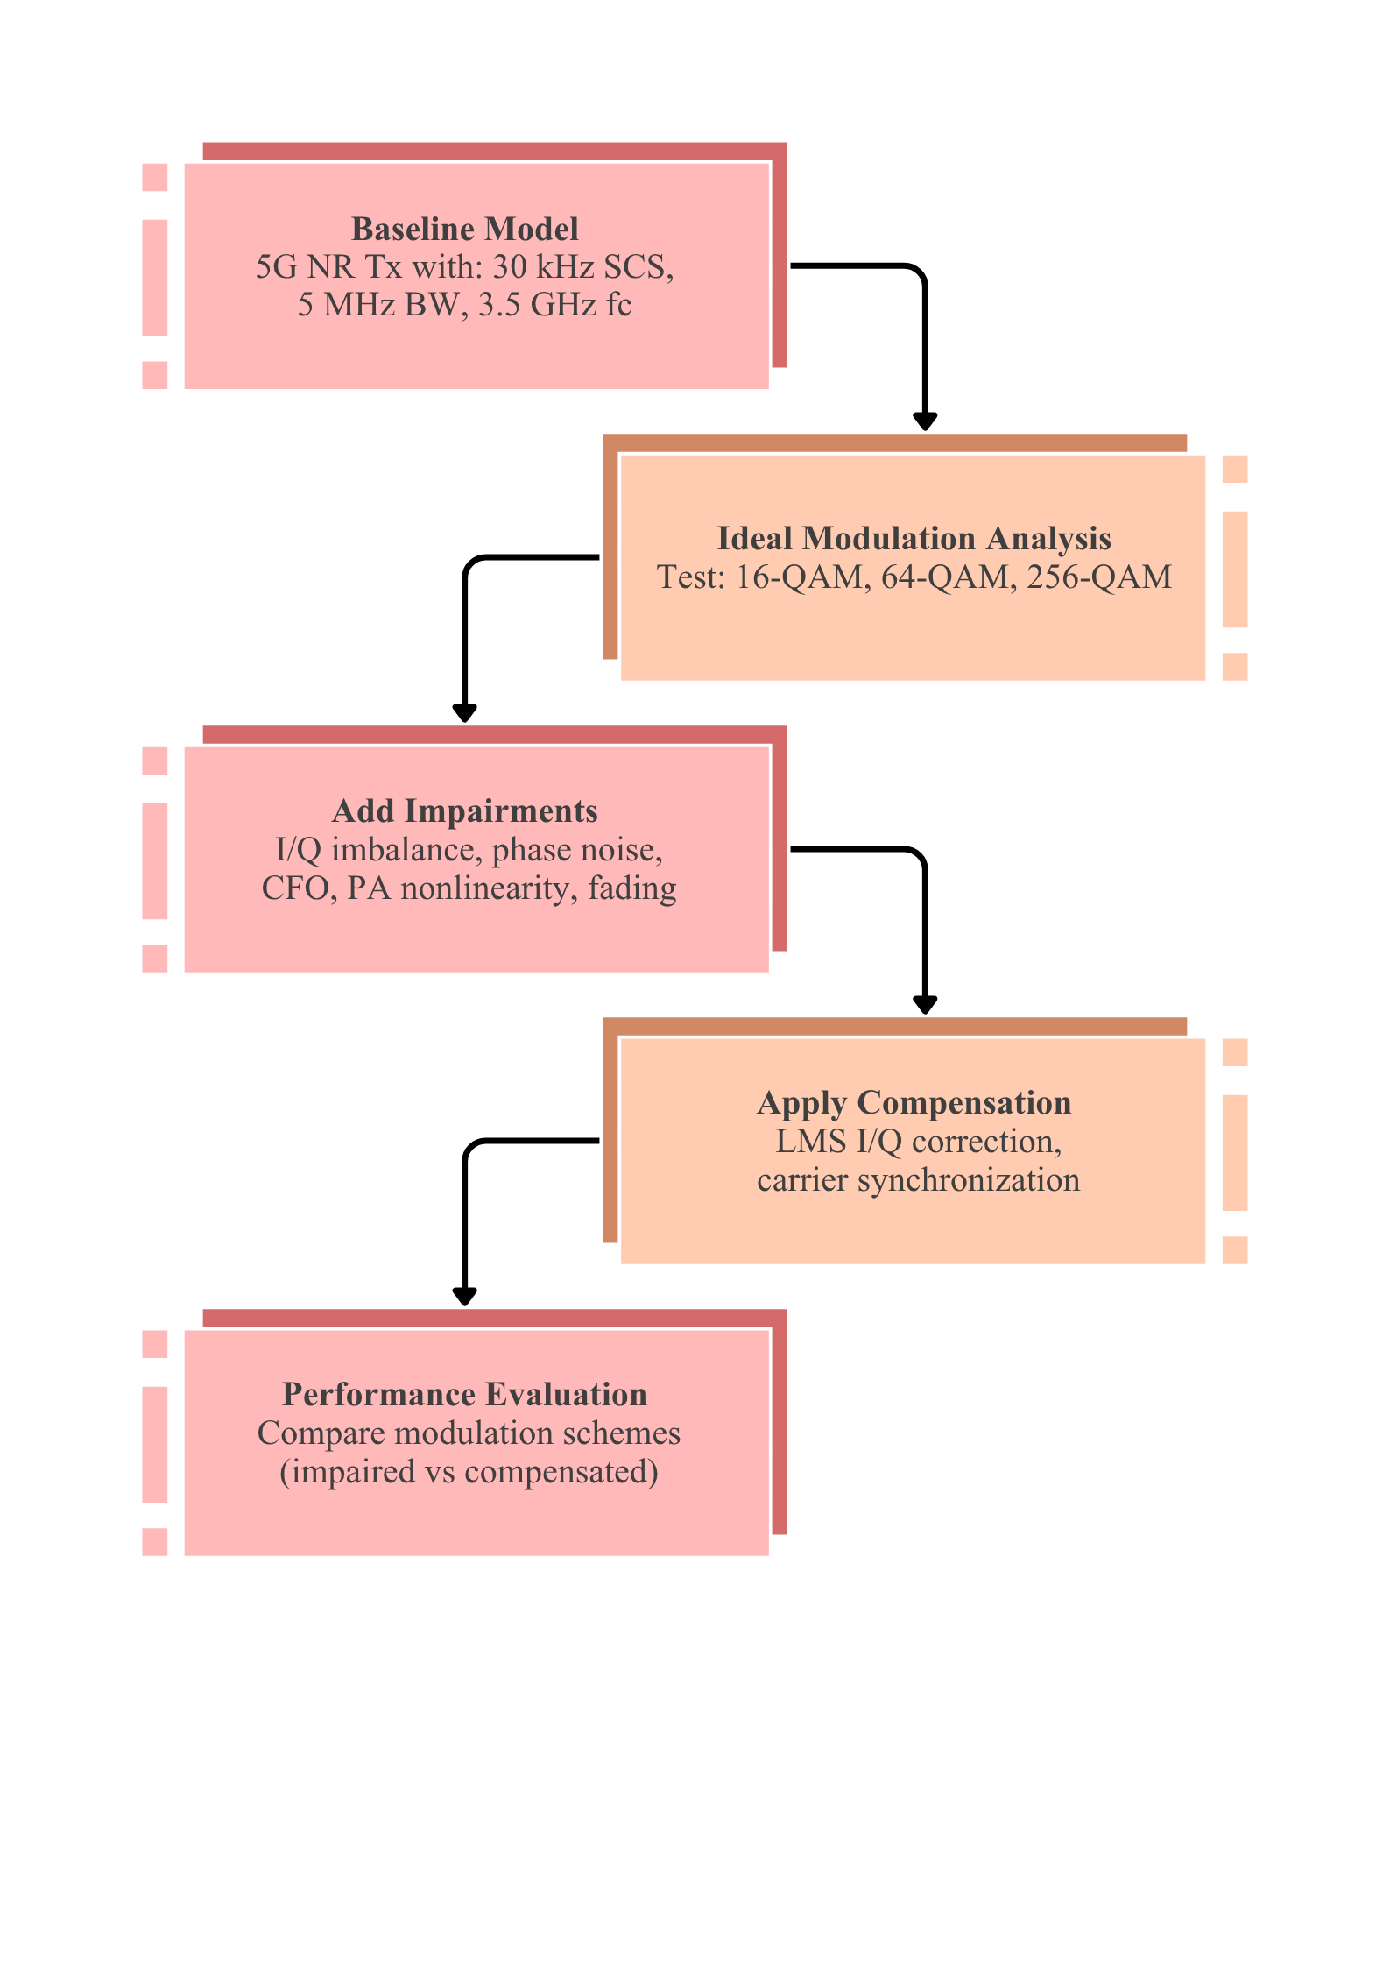
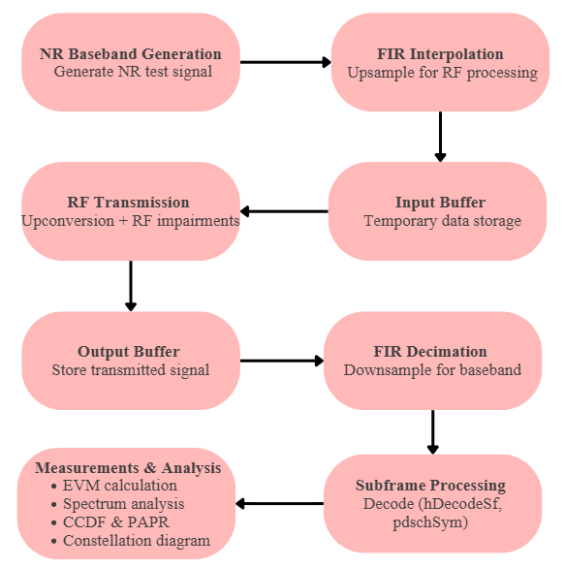
Methodology:

Slide 11
Analytical and Theoretical Description:
QAM Modulation Theory: Information is carried by varying amplitude and phase of the carrier signal. 16-QAM = 4 bits/symbol, 64-QAM = 6 bits/symbol, 256-QAM = 8 bits/symbol.
Spectral Efficiency vs Robustness: Higher-order QAM increases data rate but reduces immunity to noise and distortion.
Error Vector Magnitude (EVM): Indicates modulation accuracy by comparing ideal and received symbols. Lower EVM means better quality.
Peak-to-Average Power Ratio (PAPR): Measures signal peaks relative to average power and affects amplifier efficiency.
RF Impairment Theory: I/Q imbalance causes symbol distortion, CFO causes rotation, phase noise causes spreading, PA nonlinearity causes spectral regrowth.
Compensation Principle: LMS adaptive correction reduces I/Q mismatch, carrier synchronizer corrects frequency/phase offset.

Slide 12
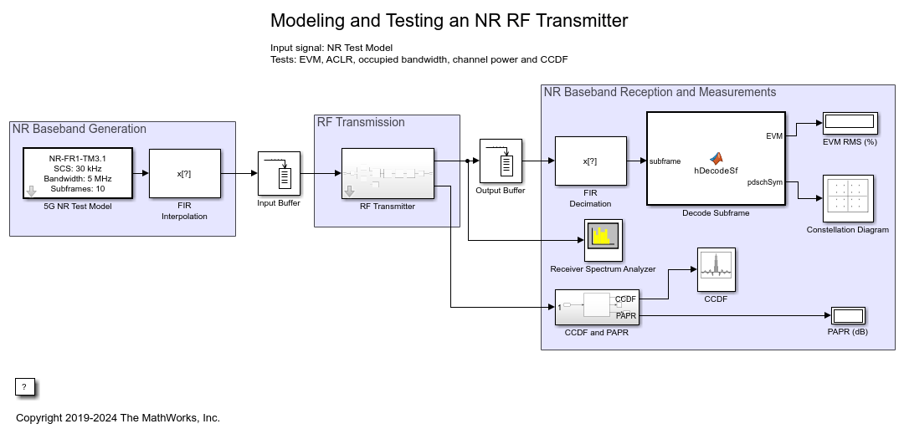
Analytical and Theoretical Description:

Slide 13
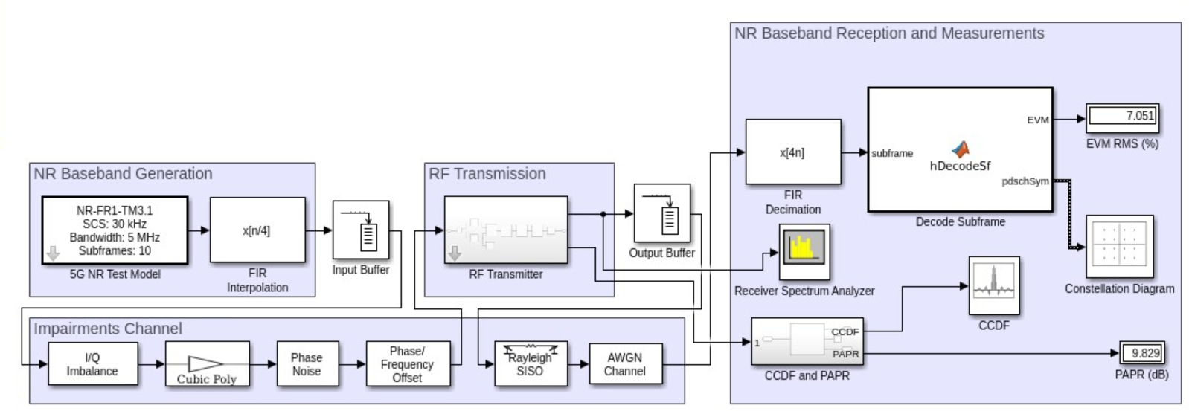
Analytical and Theoretical Description:

Slide 14
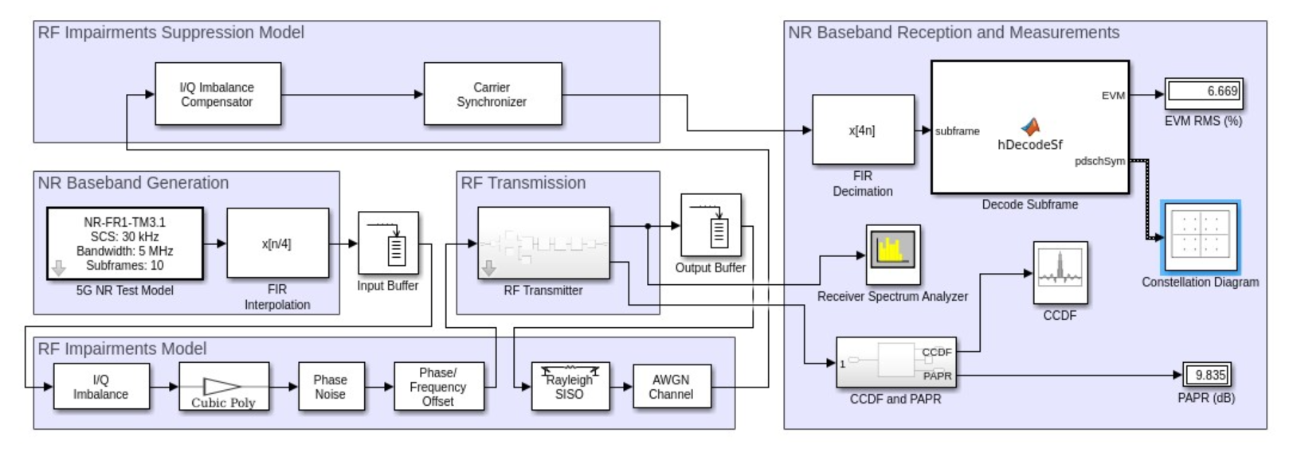
Analytical and Theoretical Description:

Slide 15
Software Tools:
MATLAB – Numerical computing and simulation platform
Simulink – Block-based system modelling and design
5G Toolbox – 5G NR waveform generation and standards-based functions
Communications Toolbox – EVM, PAPR, CCDF, modulation and signal analysis tools
Simulation Parameters:
Center Frequency: 3.5 GHz (FR1/ sub-6 band)
Subcarrier Spacing (SCS): 30 kHz
Bandwidth: 5 MHz
Modulation Type: 16-QAM, 64-QAM, 256-QAM
Duplexing: FDD
Number of Subframes: 10

Slide 16
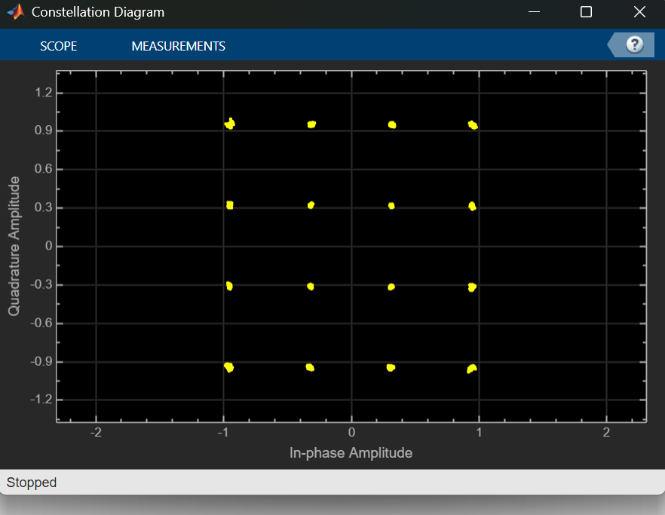
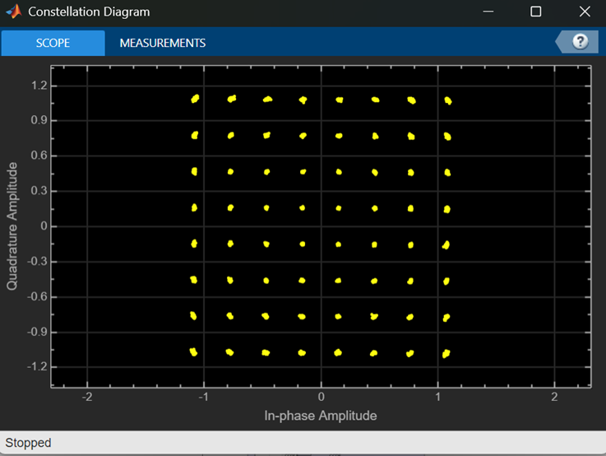
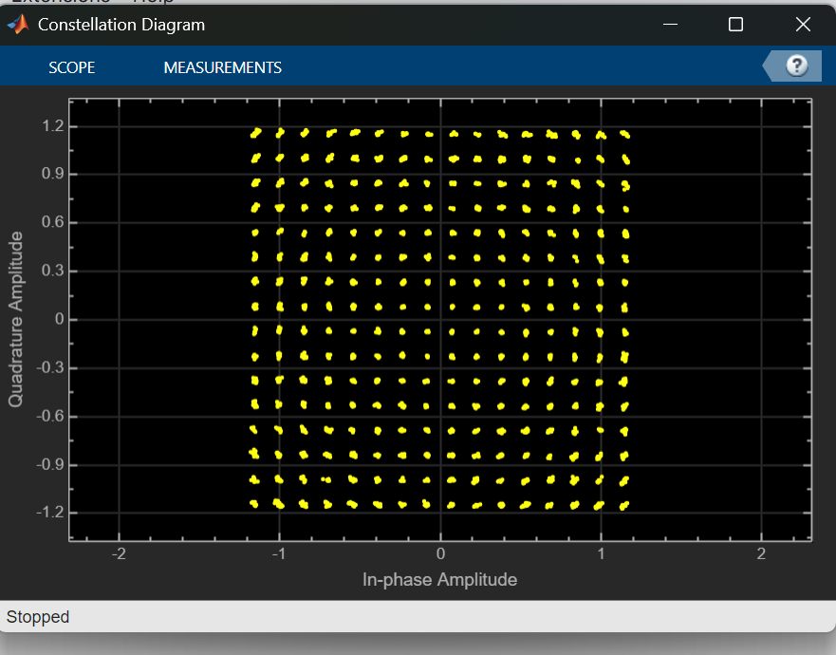
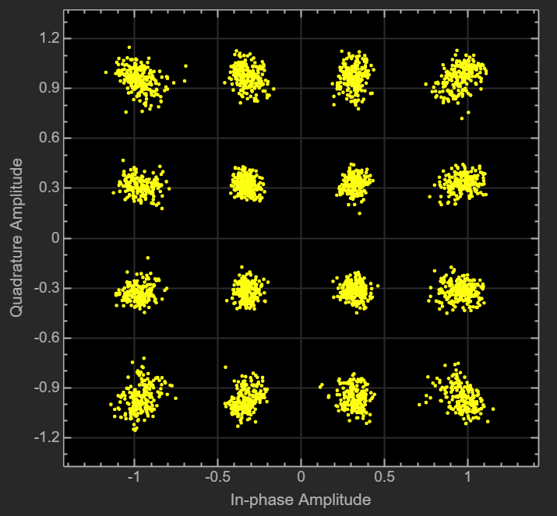
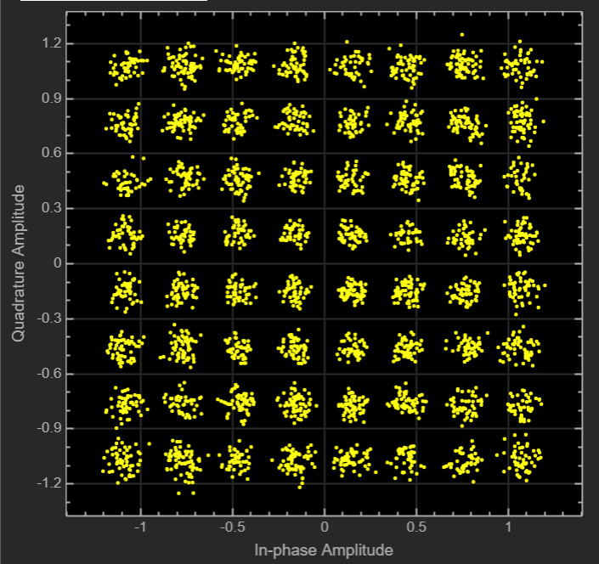
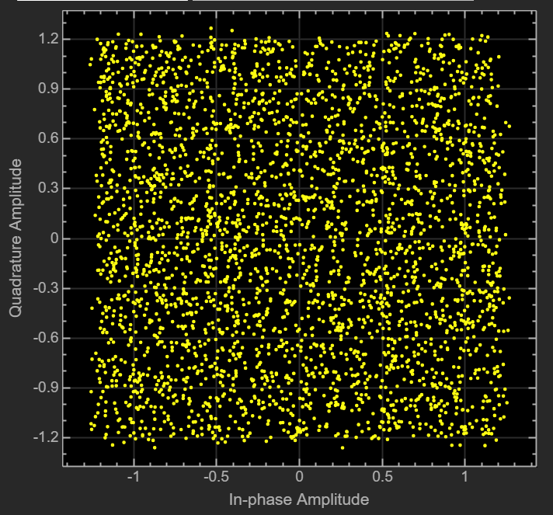
Result Analysis:
16 – QAM
64 – QAM
256 – QAM
Ideal Case
Impairments + Suppression Case

Slide 17
Result Analysis:
Modulation | Obtained EVM (Ideal) | Obtained EVM (Impairments + Suppression | 3GPP Threshold EVM | Obtained PAPR (dB) | Obtained PAPR (Impairments + Suppression | 3GPP Threshold PAPR (dB)
16-QAM | 1.21% | 6.9% | <= 12.5% | 9.71 | 10.17 | <= 10
64-QAM | 1.24% | 6.6% | <= 8% | 9.80 | 9.83 | <= 10
256-QAM | 1.22% | 5.9% | <= 3.5% | 9.57 | 9.76 | <= 10

Slide 18
Result Analysis:
Impairments | EVM Range | PAPR | Severity
Phase Noise | 1.8 – 2.57 % | ~ 9.83 dB | Medium
Carrier Frequency Offset | 2.4 – 1168 % | ~ 9.84 dB | High
I/Q Imbalance | 3.9 – 6.4 % | ~ 9.83 dB | Medium
PA Nonlinearity | 1.2 – 1.8 % | ~ 9.5 dB | Low
Rayleigh Fading | 1.2 – 1.6 % | ~ 9.7 dB | Low
AWGN | 1.26 – 1.29 % | ~ 9.8 dB | Low

Slide 19
Result Analysis:
Scenario (64-QAM) | EVM without Suppression | EVM with Suppression | Improvement
Phase Noise + CFO | 6.750% | 6.669 % | Limited
I/Q Imbalance | 6.447 % | 4.751 % | Moderate
All Impairments | 7.051 % | 6.698 % | Marginal

Slide 20
Conclusion:
A MATLAB Simulink-based 5G NR transmitter model was successfully developed and analyzed.
Performance was evaluated under ideal, impaired, and compensated operating conditions.
RF impairments such as CFO, phase noise, and I/Q imbalance significantly degrade signal quality.
Compensation techniques improved EVM and overall transmission performance.
16-QAM showed highest robustness, while 256-QAM offered maximum spectral efficiency.
64-QAM provided the best balance between robustness, efficiency, and practical implementation.
The study highlights the importance of impairment-aware design for reliable 5G NR systems.

Slide 21
Impact on Society and Environment:
Enhances reliability of 5G wireless networks for faster and stable communication.
Supports smart services such as telemedicine, smart transport, and IoT applications.
Improves digital connectivity for education, business, and remote work.
Better transmitter efficiency can reduce energy consumption in communication systems.
Optimized signal quality helps in efficient use of available radio spectrum.
Contributes to development of smart cities and modern infrastructure.
Promotes sustainable network design with improved performance and lower resource wastage.

Slide 22
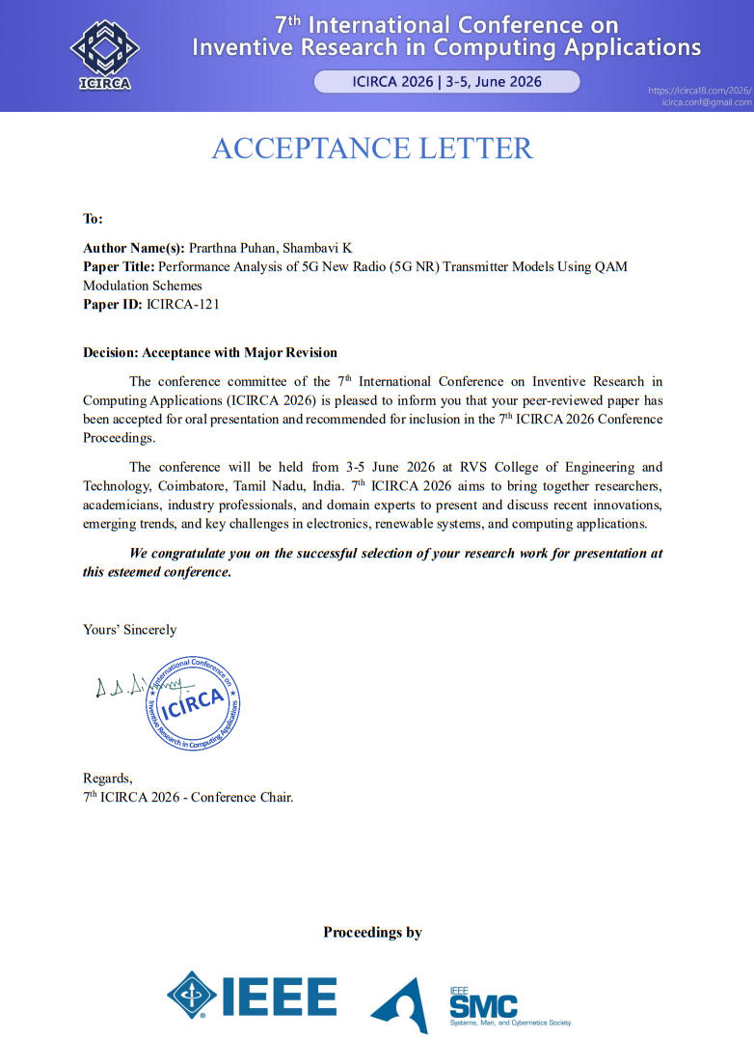
Outcome (Publication):

Slide 23
References:
T. S. Rappaport et al., “Wireless communications and applications above 100 GHz: Opportunities and challenges for 6G and beyond,” IEEE Access, vol. 7, pp. 78729–78757, 2019, doi: 10.1109/ACCESS.2019.2921522.
A. Goldsmith, Wireless Communications. Cambridge, U.K.: Cambridge Univ. Press, 2005.
A. F. Molisch, Wireless Communications, 2nd ed. Hoboken, NJ, USA: Wiley, 2011.
J. G. Proakis and M. Salehi, Digital Communications, 5th ed. New York, NY, USA: McGraw-Hill, 2008.
S. Parthasarathy et al., “Error vector magnitude analysis in generalized fading with co-channel interference,” IEEE Trans. Commun., vol. 65, no. 12, pp. 5377–5391, Dec. 2017.
A. Tarighat, R. Bagheri, and A. H. Sayed, “Compensation schemes and performance analysis of IQ imbalances in OFDM receivers,” IEEE Trans. Signal Process., vol. 53, no. 8, pp. 3257–3268, Aug. 2005.
Q. Zou, A. Tarighat, and A. H. Sayed, “Joint compensation of IQ imbalance and phase noise in OFDM wireless systems,” IEEE Trans. Commun., vol. 57, no. 2, pp. 404–414, Feb. 2009.
B. Jovanović and S. Milenković, “Transmitter IQ imbalance mitigation and PA linearization in software defined radios,” Radioengineering, vol. 31, no. 1, pp. 144–154, Apr. 2022.
S. Cripps, RF Power Amplifiers for Wireless Communications, 2nd ed. Norwood, MA, USA: Artech House, 2006.
A. Demir, “Phase noise and timing jitter in oscillators with colored-noise sources,” IEEE Trans. Circuits Syst. I, vol. 49, no. 12, pp. 1782–1791, Dec. 2002.
A. Georgiadis and C. Kalialakis, “Evaluation of error vector magnitude due to combined IQ imbalances and phase noise,” IET Circuits, Devices & Systems, vol. 8, no. 6, pp. 441–448, 2014.
I. Pyatin et al., “Radio frequency interface quality assessment in 4G/5G: Effects of IQ imbalance, phase noise, and nonlinearities on error vector magnitude,” IEEE Access, vol. 11, pp. 1–15, 2023.
B. O. Omijeh and E. E. Ibara, “Modeling and simulation of phase noise effect on 256-QAM,” Int. J. Wireless Commun. Mobile Comput., vol. 3, no. 6, pp. 72–76, 2015.
A. Halder et al., “MATLAB Simulink study on the performance of QAM modulation in AWGN, Rayleigh, and Rician fading channels: BER analysis,” Irish Interdisciplinary J. Sci. & Res., vol. 7, no. 2, pp. 34–41, 2023.
M. Valkama, M. Renfors, and V. Koivunen, “Advanced methods for I/Q imbalance compensation in communication receivers,” IEEE Trans. Signal Process., vol. 49, no. 10, pp. 2335–2344, Oct. 2001.
P. Song et al., “Blind estimation algorithms for I/Q imbalance in direct down-conversion receivers,” in Proc. IEEE VTC-Fall, 2018.
Q. Zou, A. Tarighat, and A. H. Sayed, “Joint compensation of IQ imbalance and phase noise in OFDM systems,” in Proc. Asilomar Conf., 2006.
D. Tandur and M. Moonen, “Efficient compensation of transmitter and receiver IQ imbalance in OFDM systems,” EURASIP J. Adv. Signal Process., 2010.
D. Morgan et al., “A generalized memory polynomial model for digital predistortion of RF power amplifiers,” IEEE Trans. Signal Process., vol. 54, no. 10, pp. 3852–3860, Oct. 2006.
G. Somasundaram et al., “Effective digital predistortion (DPD) on a broadband millimeter-wave GaN power amplifier using LTE 64-QAM waveforms,” Electronics, vol. 12, no. 13, Art. no. 2869, 2023.
A. Leshem and M. Yemini, “Phase noise compensation for OFDM systems,” IEEE Trans. Signal Process., vol. 65, no. 21, pp. 5675–5688, Nov. 2017.
H. Mehrpouyan et al., “Joint estimation of channel and oscillator phase noise in MIMO systems,” IEEE Trans. Signal Process., vol. 60, no. 9, pp. 4790–4807, Sep. 2012.
A. A. Nasir et al., “Timing and carrier synchronization in wireless communication systems,” EURASIP J. Wireless Commun. Netw., 2016

Slide 24
Thank you

Slide 25
Base Transmitter Block:
Creates the 5G NR test signal with defined parameters (subcarrier spacing, bandwidth, subframes).
Applies FIR interpolation to increase sampling rate for RF transmission.
Main Block

Slide 26
Base Transmitter Block:
Stores the transmitted RF signal before passing it to the receiver section.
Provides stability for further measurement and analysis.
Temporarily stores the generated baseband signal before sending it to the RF transmitter.
Ensures smooth data flow without loss.
Main Block

Slide 27
Base Transmitter Block:
Converts the digital baseband signal into an RF signal suitable for wireless transmission.
Models real RF transmitter effects such as filtering, amplification, and distortion.
Main Block

Slide 28
Base Transmitter Block:
FIR Decimation reduces the sampling rate to recover the baseband signal.
Decode Subframe extracts useful symbols and data.
Measurement tools:
EVM (Error Vector Magnitude): Signal quality.
Constellation Diagram: Symbol mapping accuracy.
Spectrum Analyzer: Occupied bandwidth and spectral shape.
CCDF & PAPR: Power efficiency and peak signal behaviour.
Main Block

Slide 29
Transmitter Block (with Impairments Blocks, 64-QAM)
Models amplitude and phase mismatch between I and Q branches in the transmitter/receiver.
Causes constellation skewing and image interference, increasing EVM; common in practical RF chains due to imperfect mixers.
Main Block

Slide 30
Transmitter Block (with Impairments Blocks, 64-QAM)
Represents nonlinear behavior of the power amplifier using a third-order polynomial model.
Introduces spectral regrowth and constellation compression, degrading ACLR and EVM; critical for high-PAPR OFDM signals.
Main Block

Slide 31
Transmitter Block (with Impairments Blocks, 64-QAM)
Adds random phase fluctuations due to imperfect oscillators.
Causes constellation rotation and spreading, severely affecting high-order QAM.
Main Block

Slide 32
Transmitter Block (with Impairments Blocks, 64-QAM)
Models mismatch between transmitter and receiver oscillator frequencies.
Breaks OFDM subcarrier orthogonality, causing inter-carrier interference (ICI).
Main Block

Slide 33
Transmitter Block (with Impairments Blocks, 64-QAM)
RAYLEIGH FADING
Models multipath fading without a line-of-sight (NLOS) component.
Represents urban or indoor environments where signals reflect and scatter.
RICIAN FADING
Models multipath fading with a dominant line-of-sight (LOS) path.
Accurately represents scenarios like outdoor small cells and mmWave links.
Main Block

Slide 34
Transmitter Block (with Impairments Blocks, 64-QAM)
Adds white Gaussian noise to the signal.
Models thermal noise and sets the baseline noise floor for performance evaluation.
Main Block

Slide 35
Transmitter Block (with Impairments + Suppression Blocks, 64-QAM)
Corrects amplitude and phase mismatch between the In-phase (I) and Quadrature (Q) signals caused by RF hardware imperfections.
Restores proper orthogonality (90° phase difference) between I and Q components.
Improves signal quality and constellation accuracy, reducing EVM for better demodulation.
Main Block

Slide 36
Transmitter Block (with Impairments + Suppression Blocks, 64-QAM)
Corrects carrier frequency and phase offsets between the transmitter and receiver signals.
Aligns the received signal with the local oscillator reference for accurate demodulation.
Reduces phase errors and constellation rotation, improving symbol detection and lowering EVM.
Main Block

